Slide 1
Project proposal on Microprocessors & Microcontrollers Laboratory (EEE 372) Title - PUC Covid-19 Tracker.
Supervised by
Kingshuk Dhar
Assistant Professor
Department of Computer Science & Engineering.
Premier University Chittagong.
Presented by
Mujibur Rahman (1703310201390)
Sourav Dev Nath (1703310201385)
Mehedi Hasan Ovi (1703310201423)
Fahad Abdullah (1703310201394)
Mohammad Minhaz Uddin(1703310201419)

Slide 2
Introduction
01
Objectives
Human Covid-19 detector using Arduino Uno R3.
This piece of machinery is one part of a COVID-19 detector. This part although cannot detect if the person has COVID-19 but it can detect whether the person is ready to take the COVID test.
It is a “Digital Non-Contact Infrared Thermometer” scanner that lets the authority know or the machine know about the condition of the person.
It will ensure health security of the University.
Now we shall begin.
02
Methodology
03
Circuit Diagram
04
Flowchart
05
Notes:
© Copyright PresentationGO.com – The free PowerPoint and Google Slides template library

Slide 3
Introduction
01
Objectives
To design and implement a machinery to measure temperature of all the students or many students at a time.
To establish a machinery to save time.
To record or monitor student’s health condition.
It is quite tough for the security to measure temperature of all the students or many students at a time with the temperature gun.
It is time consuming.
No facilities to record or monitor student’s health condition.
02
Methodology
03
Circuit Diagram
04
Flowchart
05
Notes:
© Copyright PresentationGO.com – The free PowerPoint and Google Slides template library

Slide 4
Introduction
01
The an Arduino Uno R3 based project.
RFID sensor will collect the student’s ID.
Arduino will process and get the information of student’s name and batch using the ID card.
The Digital Non-Contact Infrared Thermometer (MLX90614) will take the temperature if those information are matched.
Arduino will check if the temperature is alarming.
If there is alarming sign, the door will not open and the security will receive a warning message.
Else the gate will open.
Objectives
02
Methodology
03
Circuit Diagram
04
Flowchart
05
Notes:
© Copyright PresentationGO.com – The free PowerPoint and Google Slides template library

Slide 5
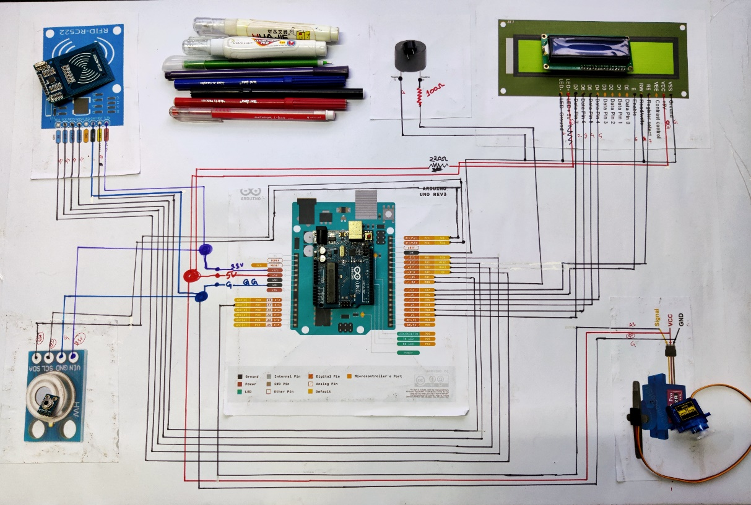
Introduction
01
Objectives
02
Methodology
03
Circuit Diagram
04
Flowchart
05
Notes:
© Copyright PresentationGO.com – The free PowerPoint and Google Slides template library

Slide 6
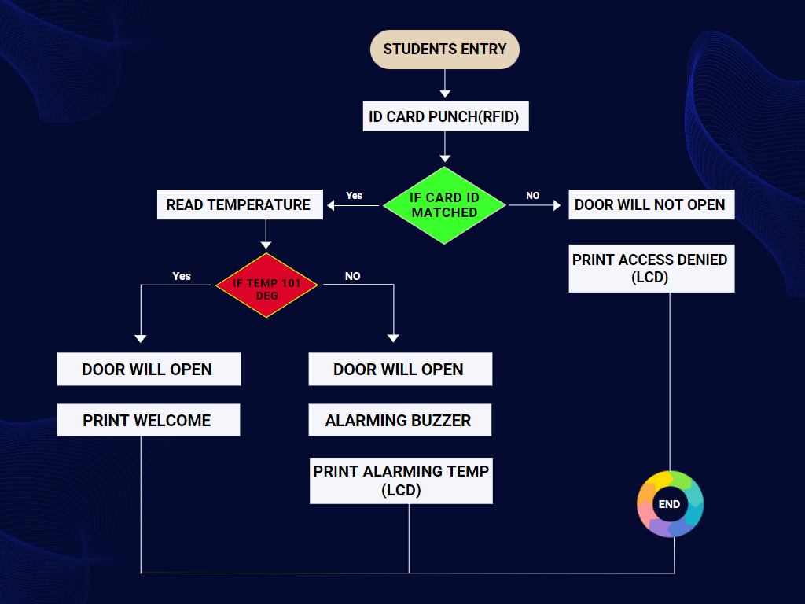
Introduction
01
Problem statement
02
Objectives
03
Circuit Diagram
04
Flowchart
05
Notes:
© Copyright PresentationGO.com – The free PowerPoint and Google Slides template library

Slide 7
Thank you.
Any question?
Notes:
© Copyright PresentationGO.com – The free PowerPoint and Google Slides template library

Slide 8
